Slide 1
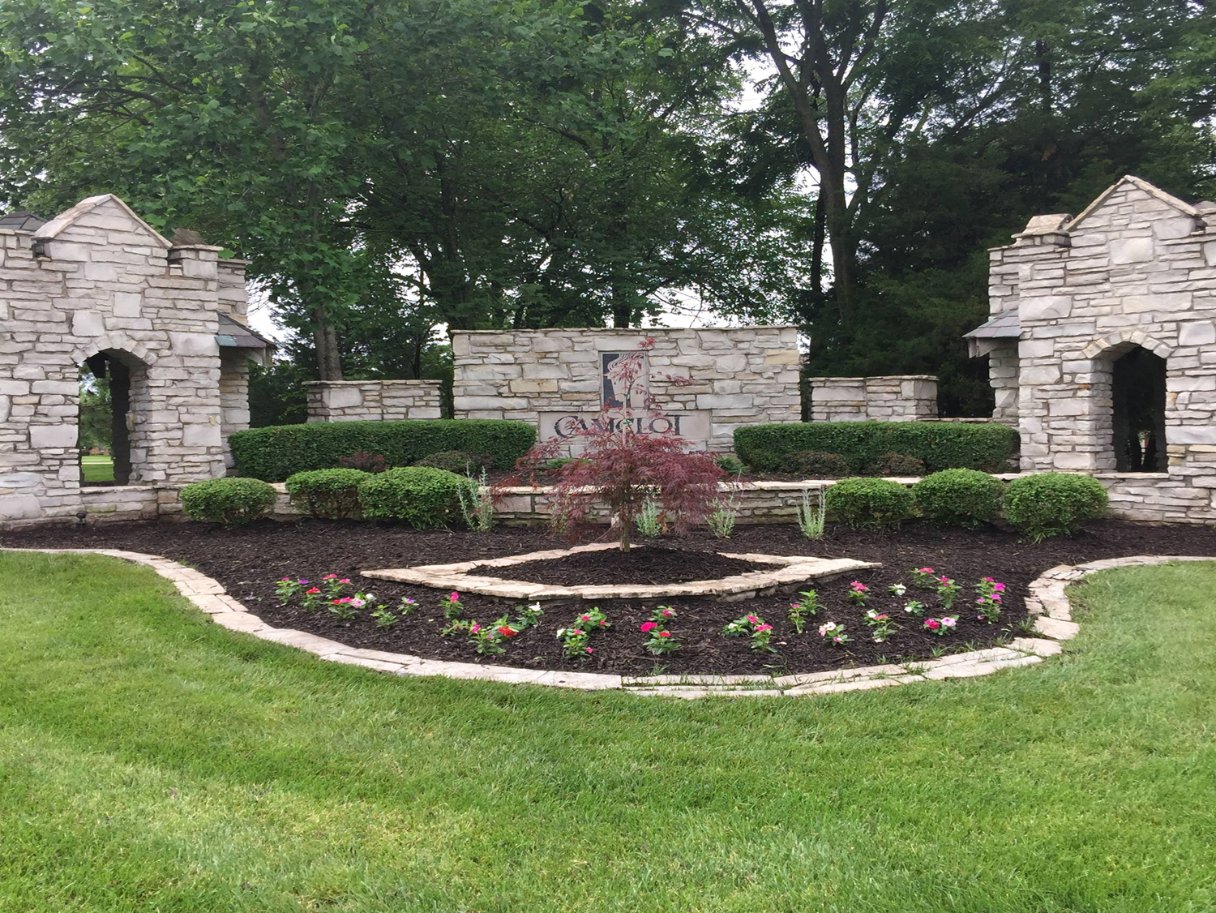
Camelot Subdivision Annual HOA Meeting
Weldon Spring City Hall
February 11, 2025
7:00 pm

Slide 2

2025 Camelot HOA Board – Trustees
John Hoenig – President
Kristy Kniest
JoAnne Dunaway
Lisa Erhardt
Steve Swan
  If you would like to serve as a volunteer or have an interest being a Trustee, please notify us before the end of the meeting.
  We need new volunteers to become familiar with the HOA so we can smoothly transition when board members step down.
  Does not require a large time commitment.

Slide 3

Welcome Mike Elam
I 3 Broadband to discuss fiber optics
        I#

Slide 4

Rules of order and meeting cadence
The presenters will discuss each section and then address a few related questions so please hold all questions until the presenter completes each section.
If Q&A extends too long or questions require a complex answer, we will ask you to hold until the end of the meeting. We will continue to answer questions until 8:30 pm or until questions are exhausted.
Online participants: Please email questions to
kristenkniest@gmail.com or joanne.camelot@gmail.com
Questions submitted during the meeting will be answered within the next week.

Slide 5
Agenda
i. HOA Board
ii. Mike Elam I 3 Broadband
iii. Rules of Order Meeting Cadence
iv. Agenda
v. City and Village and Services Funded by your Annual Assessments
vi. Finances
vii. Looking Ahead
viii. Common Grounds, Trails, Lakes
ix. Volunteers
x. Open Q&A

Slide 6
City & Village Tax Office
Collect our Assessments and Disburse Funds
Assessments can be paid through the portal on their website
Reminder: HOA Fee due by 1 Jan (delinquent on 2 March)
Presently we use the Camelot Facebook page and Annual Newsletter & Meeting to communicate with the Homeowners
You can register your email address as a homeowner on the City & Village portal which at some point will give us the ability to communicate more directly in the future.

Slide 7
Services funded by your Annual Assessments
Leased streetlights and service costs
Water, irrigation, and low voltage lights at monument area
Lawn maintenance common grounds of about 11 acres
Retention pond maintenance: natural water treatment, fish, fountains, aerators, banks and dredging
Maintenance of paths
Maintenance of street signs and other signs
Seasonal decor at monument area
Liability insurance for common grounds and for directors/trustees
Insurance on monuments
Operating expenses of the Association: taxes, fees to City and Village, CPA, legal fees, postage and mailings
Security certificates, domains, contractor for our web site

Slide 8
Finances
2024 Review
2025 Budget

Slide 9
Fiscal Year End 2024
FYE resulted in a cash balance of $174.8k but this cash balance includes prepaid 2025 Assessments of 13.7k for a book over-statement of cash of this amount.
Expenses were 27k higher than planned due to repairs located around the 3 retention ponds. These repairs were the result of 3 high volume rains that eroded inlets and paths. The expense budget was 75.8k compared to actual expenses of 102.7k.
The retention drainage area off Cornwall Drive was heavily damaged by high water volume, was repaired and damaged even further by a subsequent high rain event. This cost us close to 10k for unplanned repairs. This stormwater outlet pulls a very large volume of rainwater from Lancelot, Camelot Drive, and Cornwall with a complex pipe and inlet design.

Slide 10
Budget for 2025
We are planning an expense budget of 85.5k for 2025 which is 10k than the 2024 budget but is 17k less than the actual expenses for 2024.
Most expenses by category are controllable, like street light expenses, but the ponds and grounds are less controllable due to aging of the grounds and weather conditions. Record rain events, erosion, washouts, and a larger number of dead trees are unpredictable and can be costly.

Slide 11
Impacts to Our Financial Future
Camelot is an aging community almost 30 years old
There are issues related to the age of the community which will need to be addressed over time, here are three items as an example:
  Dredging the lakes: these are six figure expenses, messy and dredging takes months
  Mitigation of the erosion into the lakes and erosion of the lake banks: we engaged the services of a new erosion specialist/consultant (Drainscapes) to insure we are approaching the issues properly
  Storm Sewer Maintenance: we have a legal disagreement with the City of Weldon Spring: They are asserting the storm sewers were never properly dedicated and accepted by the City. We have, through legal counsel, studied the documents through sunshine laws and believe the storm sewers have been accepted by the City.

Slide 12
Looking Ahead
  Special Assessments may be necessary at some point to address any of the points referenced above.
  Possibly Amending the HOA bylaws to:
  - Allow us to resolve the storm sewer issue
  - Update some of the language to reflect a mature community with issues we are now facing versus a community under development

Slide 13
Common Grounds, Trails, Lakes
3 Extraordinarily Heavy Rain Events
Washed out trails and dumped soil and water into the lakes
Upset the balance of the lakes
Washed out the flume in the retention basin on Cornwall

Slide 14
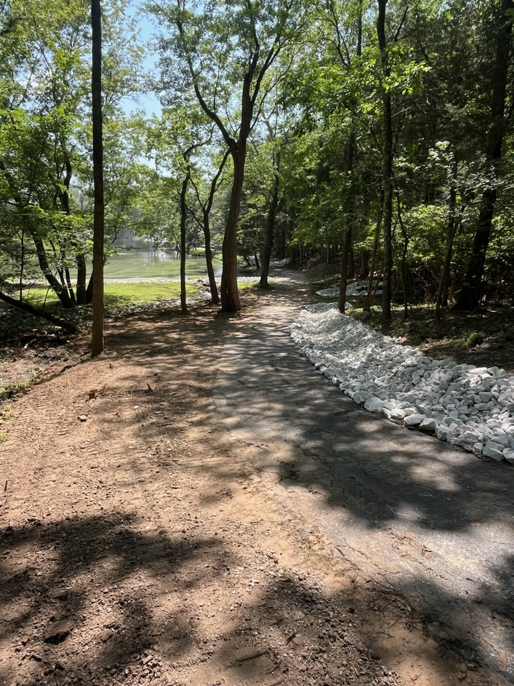
Repair Washout on Trail to Lake

Slide 15
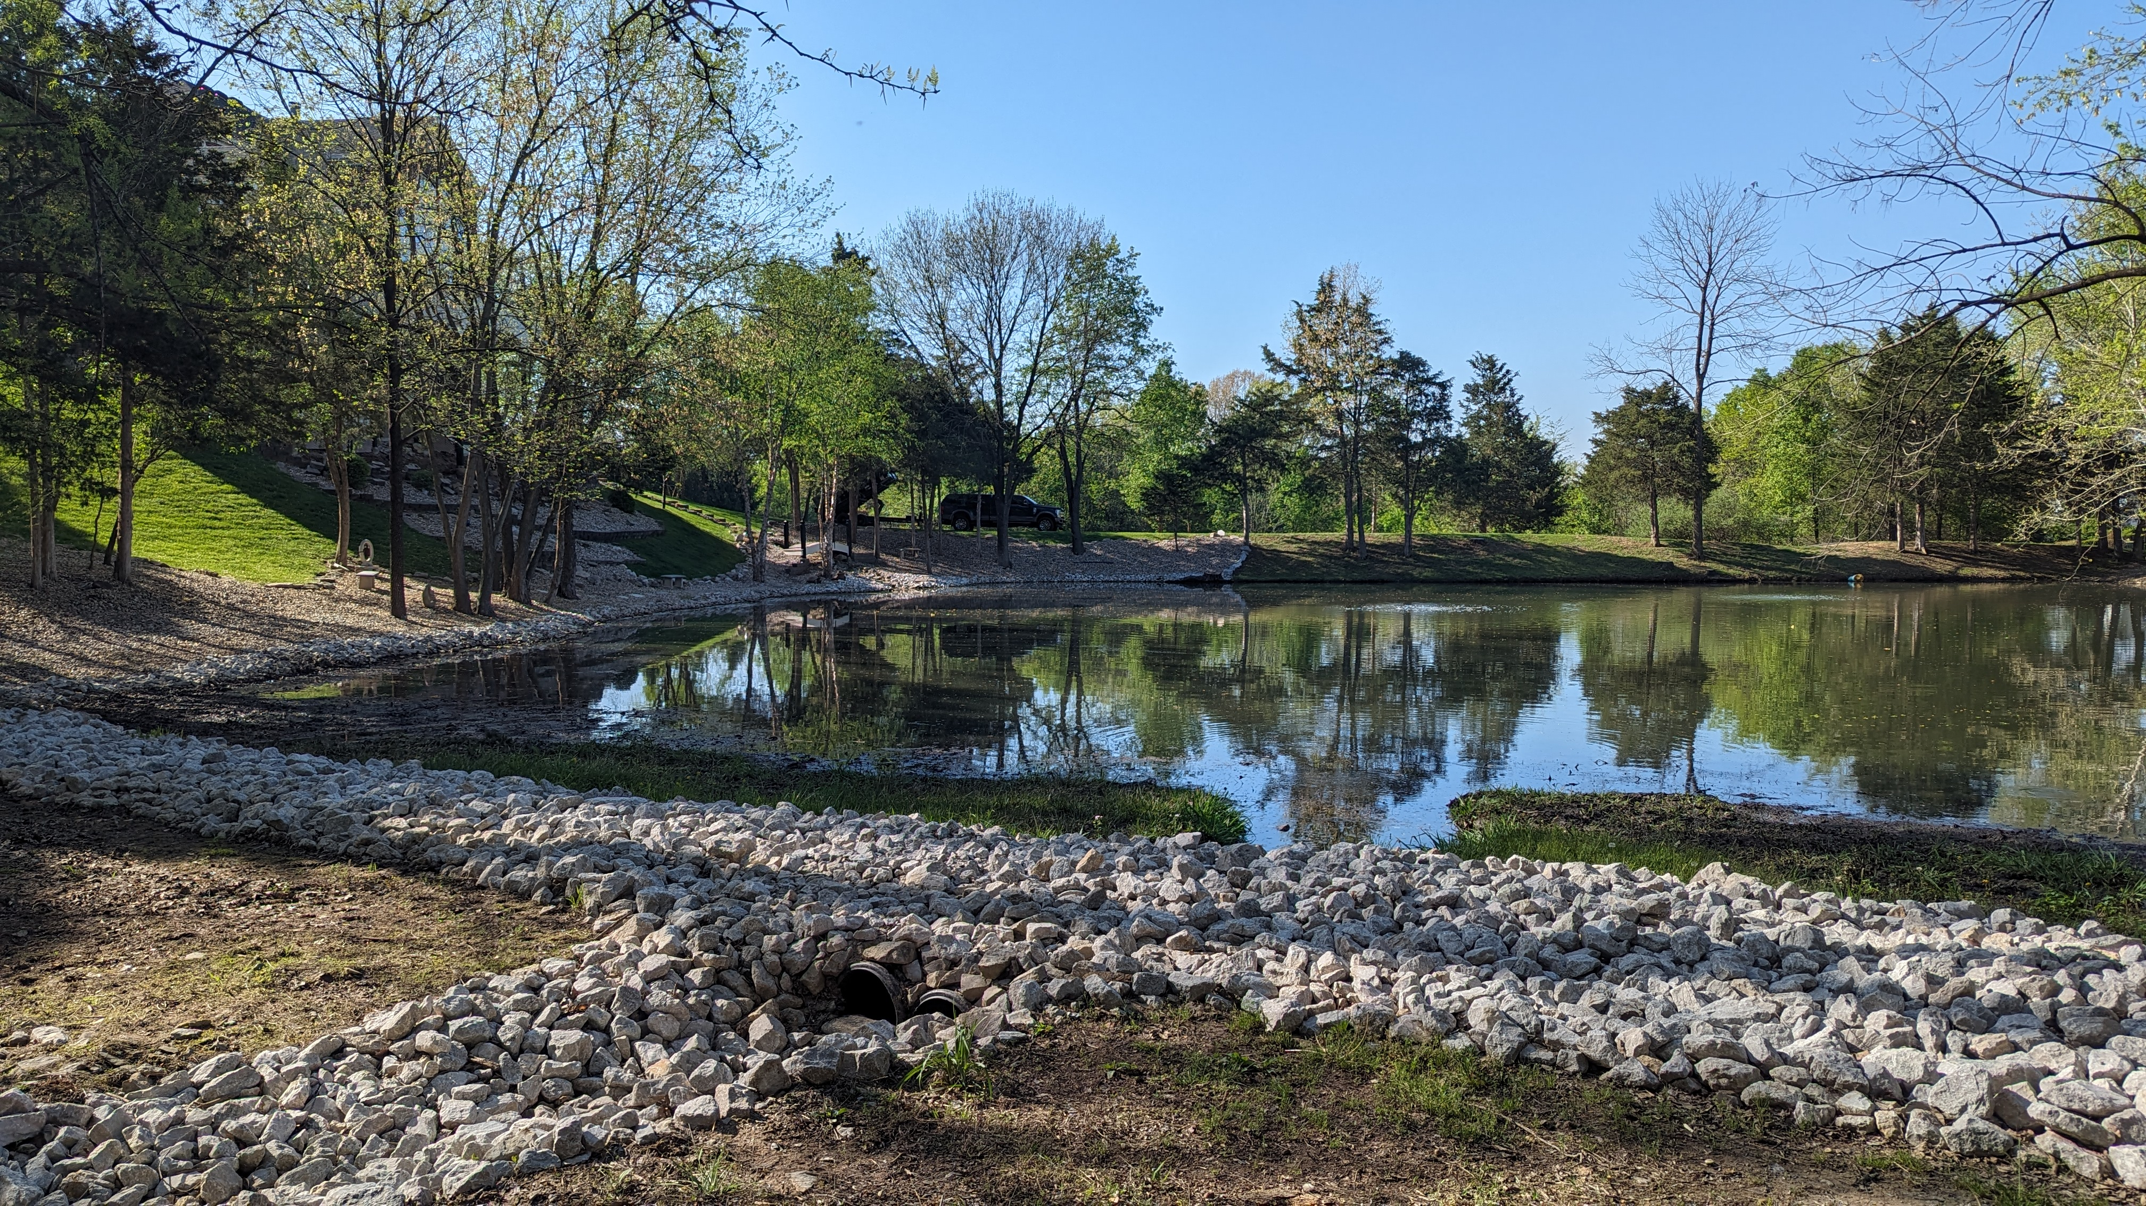
Upper Perceval

Slide 16
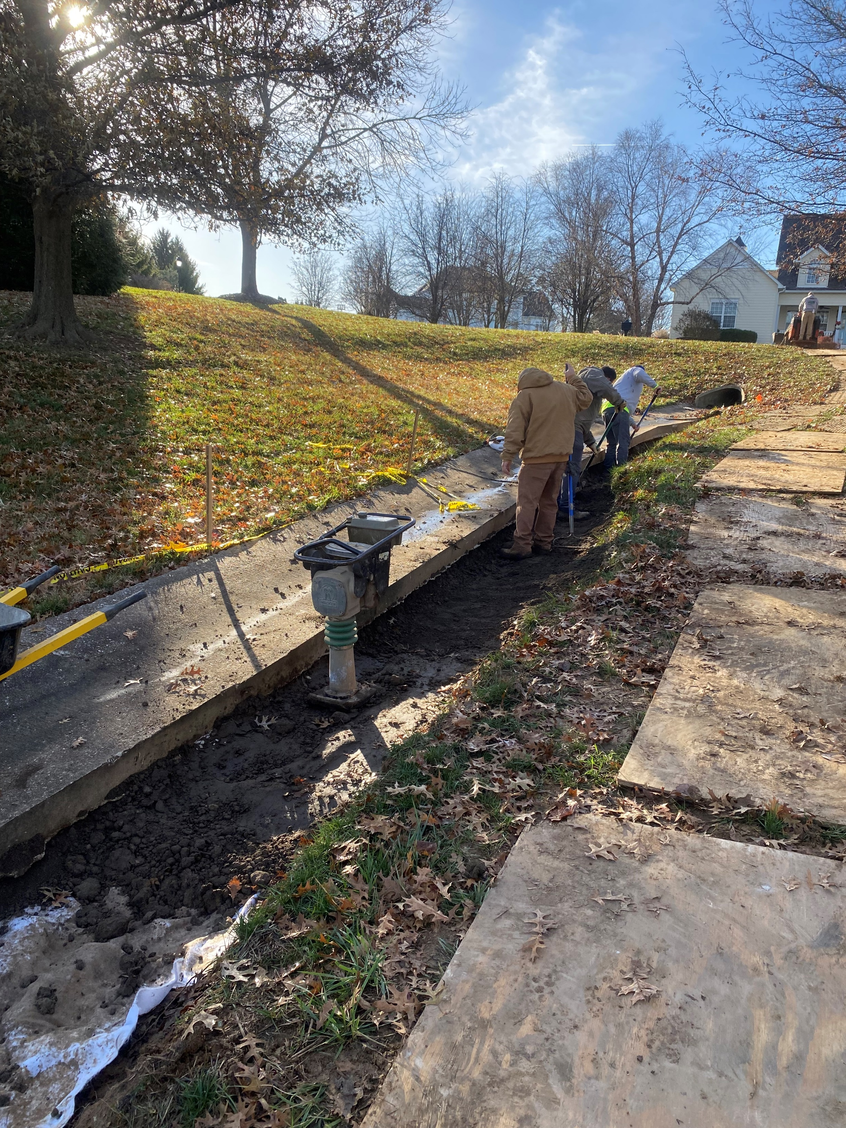
Cornwall Flume to
Retention Basin
Washed Out

Slide 17
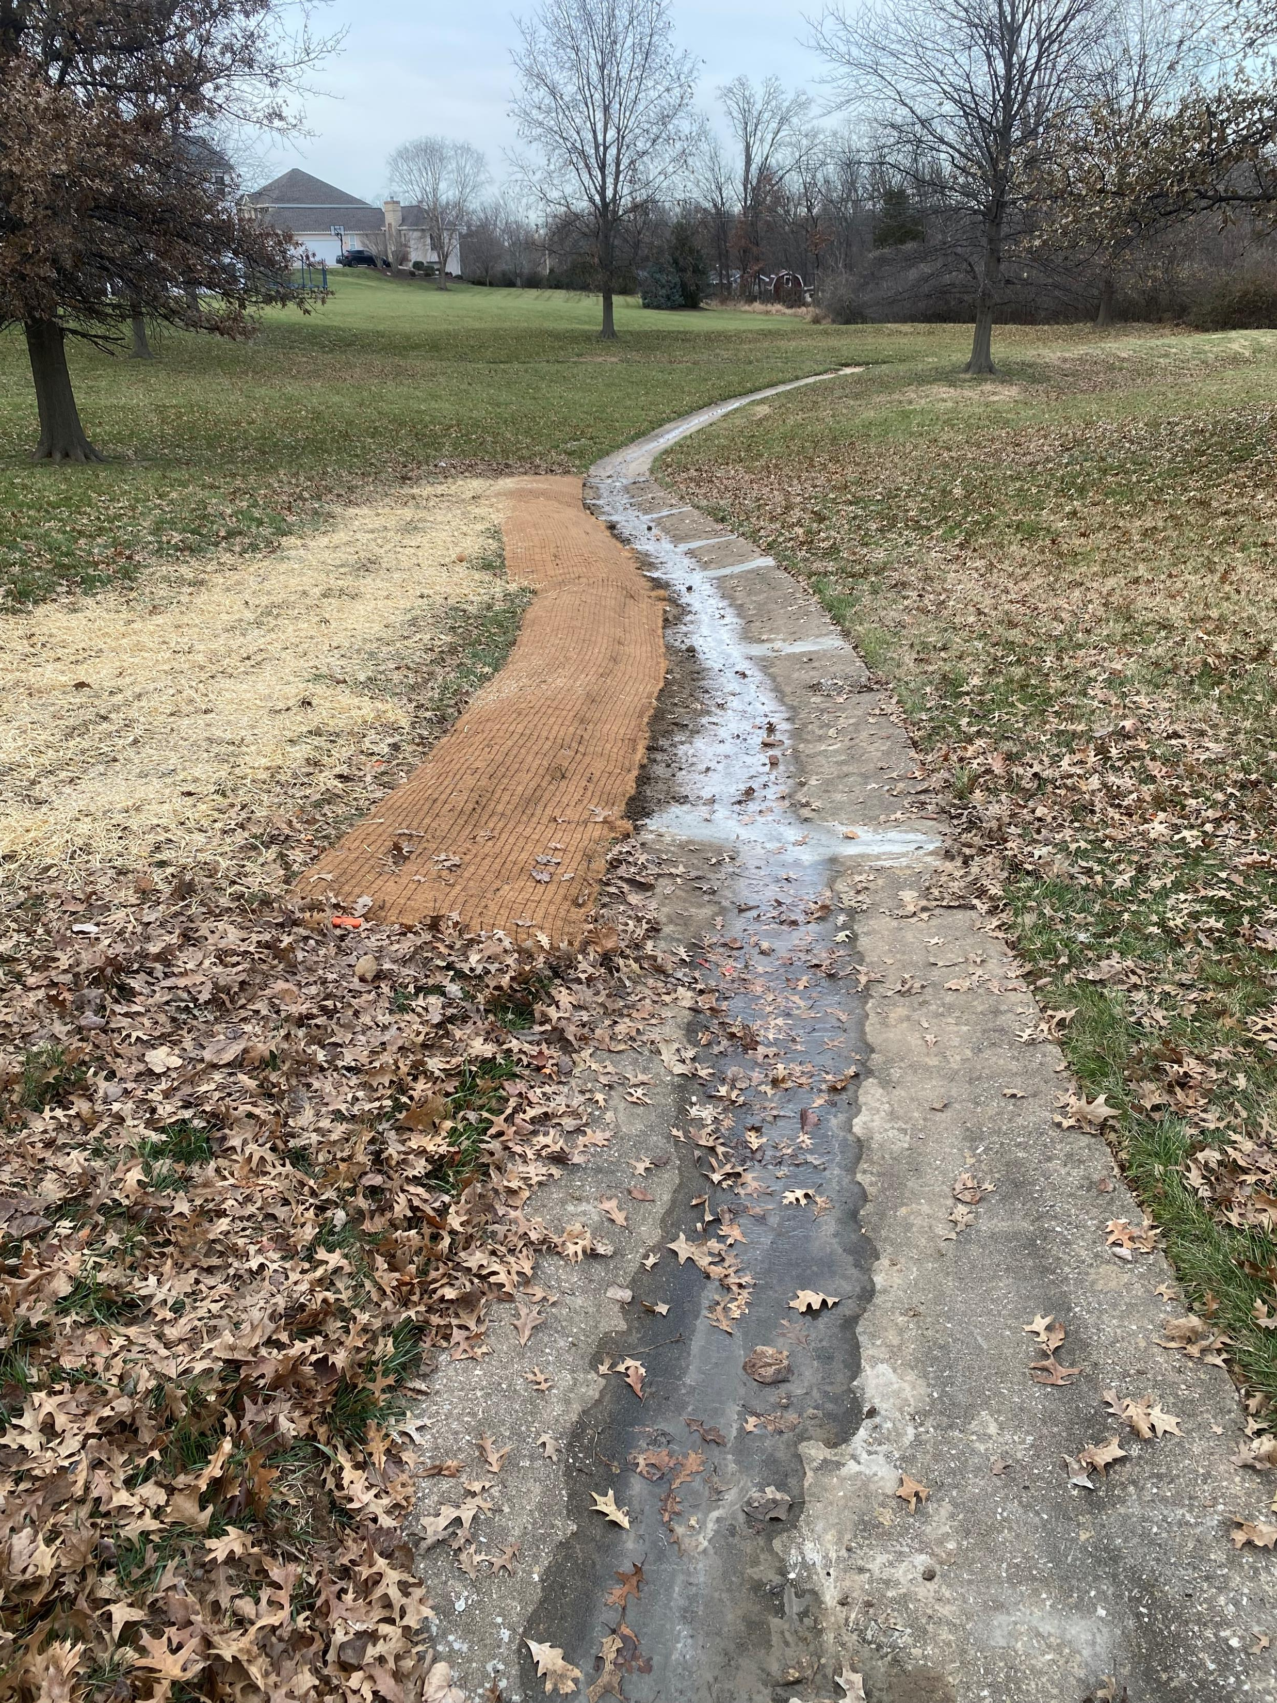
Cornwall Repair

Slide 18
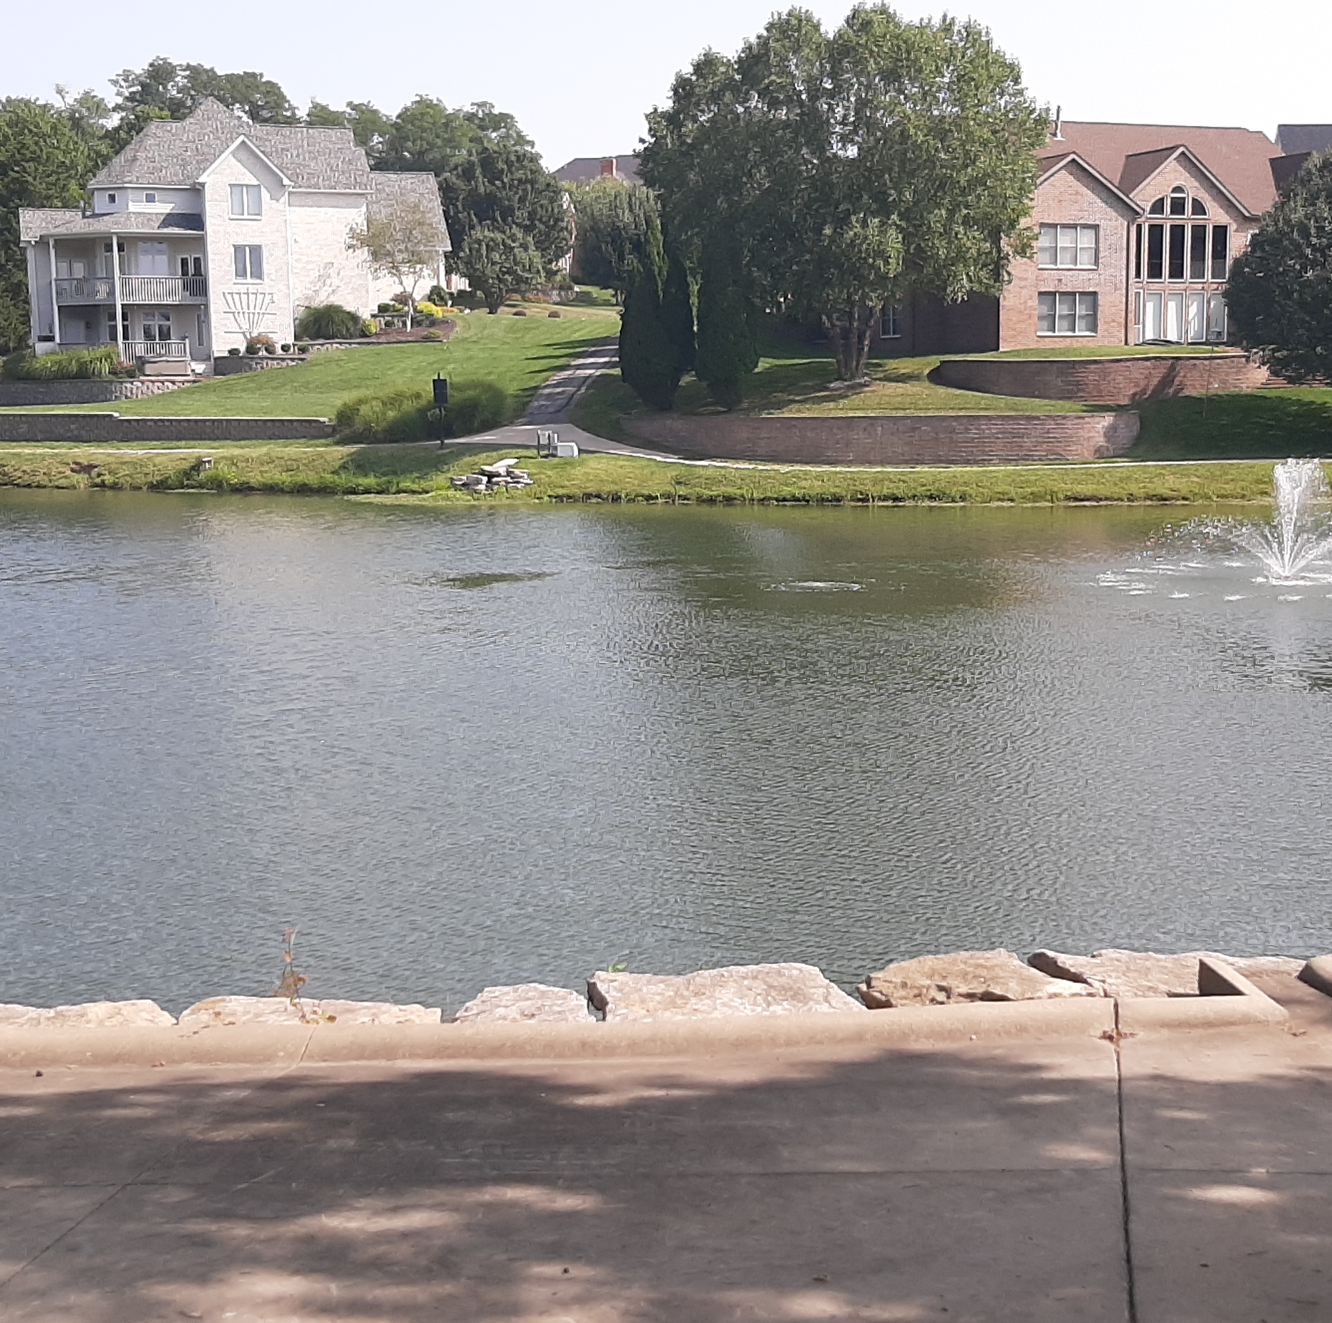
Lakes
Must be maintained consistent with Federal Clean Water Act
Contract with Solitude Lake Management renewed for 2025
- inspect 3 lakes twice/month
- address algae, weed, shoreline and aquatic control
Lakes are periodically restocked with appropriate fish through Curryville Fishery.

Slide 19
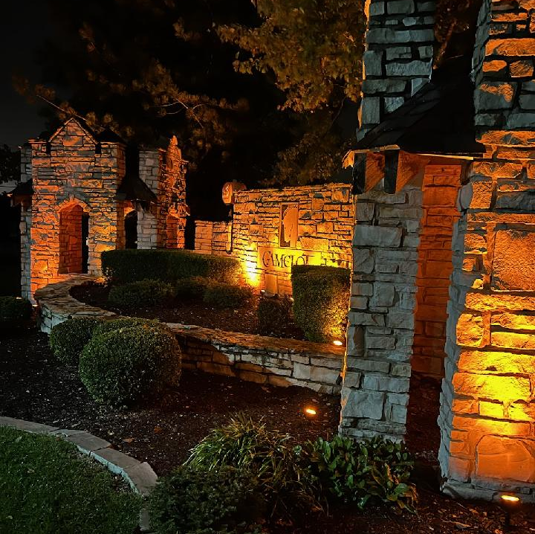
Seasonal Décor at Entrance:
Thanks to Terri Fessler

Slide 20
Thanks to Landscape Volunteers for planting at entrance.
Thanks also to Pam Hanson and Pattie Mollet who plant native plants throughout the common areas.

Slide 21
Any Trustee Volunteers?
Presently have a full board but would welcome anyone with interest in serving at some time in the future.
Call for a motion for a resolution to allow the Trustees to appoint a Trustee mid year if the need arises and we have a volunteer who is interested.

Slide 22
Open Q&A

